Slide 1
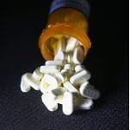
Perspectives on the U.S. Opioid Crisis
John Howard
National Institute for Occupational Safety and Health
Centers for Disease Control and Prevention
Washington, D.C.
12 March 2019
2019 Professional Development Conference
American Society of Safety Professionals
San Diego Chapter
San Diego, California

Slide 2
Overview
Terms & Toxicology
Opioids through American History
Current Public Health Emergency
How Did This Happen?
Interventions
What’s Work Got to Do with It?
Fentanyl and First Responders

Slide 3
Papaver somniferum
Opium is processed from the latex sap of the opium poppy, Papaver somniferum.
One of the oldest herbal medicines, being used as analgesic, sedative and antidiarrheal drug for thousands of years.

Slide 4
Opiate vs Opioid
Opiates
Chemical compounds that are “extracted” or “refined” from natural plant matter (poppy sap and fibers).
Opium, morphine, codeine
Opioids
Chemical compounds that generally are not derived from natural plant matter.
Most opioids are "made in the lab" or "synthesized."
Hydrocodone (Vicodin)
Oxycodone (OxyContin)
When people wish to refer to all of drugs derived from opium poppy, they often use the term "opioid."

Slide 5
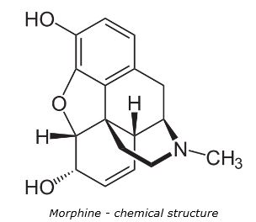
3 Categories of Opioids
Natural opioids
Including morphine and codeine
Semi-synthetic opioids
Including hydrocodone and oxycodone
Synthetic opioids
Methadone, demerol, tramadol
Fentanyl
Used to treat severe cancer pain or to manage pain after surgery
50x to 100x more potent than morphine
Sufentanil (Dsuvia)
Approved by FDA October 2018
5x to 10x stronger than fentanyl and 500 to 1000x more powerful than morphine
Useful for soldiers sublingually who cannot obtain intravenous opioids for acute pain
Carfentanil
Used in veterinary medicine for sedating elephants
10,000x more potent than morphine

Slide 6
Pathophysiology
Opioids increase activity at mu (μ), kappa (κ), and delta (δ) opioid receptors.
Opioid receptors are activated by both endogenous (endorphins) and exogenous (opioids) compounds.
Mu receptors are responsible for most of the clinical effects:
Regulate the perception of pain (analgesia) & pleasure (euphoria)
Rewarding effects of opioids are accentuated mostly when the drugs are delivered rapidly to the brain—insufflation (snorting); intravenous (mainlining).

Slide 7
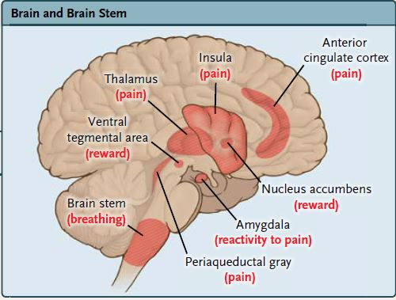
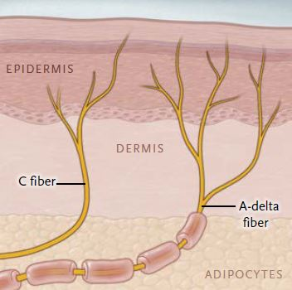
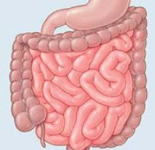
Location of Mu-Opioid Receptors
Brain and Brain Stem
High concentration in the thalamus, periaqueductal gray, insula, and anterior cingulate (regions involved with pain perception), in the ventral tegmental area and nucleus accumbens (regions involved with reward), in the amygdala (a region involved with emotional reactivity to pain), and in the brain stem (nuclei that regulate breathing).
Spinal Cord
High concentration of mu-opioid receptors is located in the dorsal horn.
Peripheral Nervous System
Modulate the perception of pain.
Intestine
Regulates gut motility.

Slide 8
Toxicokinetics 1
Expected pharmacokinetics from appropriate dosing is not applicable in misuse situations leading to overdoses
Tablet “bezoars” have erratic rates of absorption; delayed gastric emptying and decreased gut motility can decrease drug absorption
Drug misuse behaviors increase rate of absorption—insufflating or injecting tablets, or heating fentanyl patches.

Slide 9
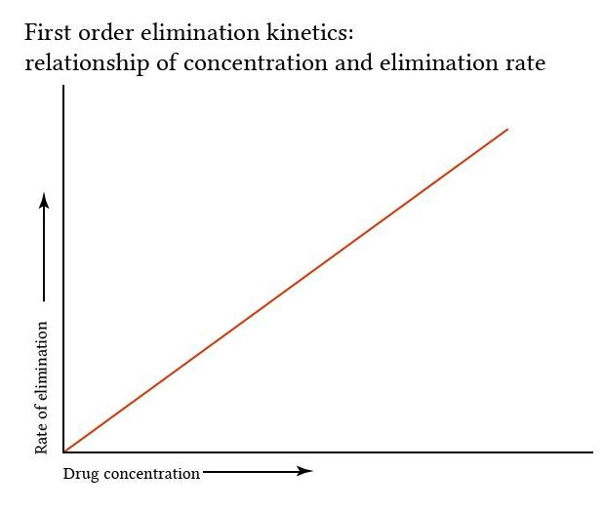
Toxicokinetics 2
Opioids, like other meds, undergo first order elimination—constant fraction is converted to metabolites by enzymatic processes per unit of time—the higher the concentration the faster the clearance.

Slide 10
Toxicokinetics 3
● High concentrations overwhelm enzyme systems resulting in saturation—converting 1st order to zero order elimination—rate of elimination is independent of the concentration.
● These toxicokinetic effects can produce opioid toxicity that may be severe, delayed in onset, and protracted as compared with expected therapeutic actions.

Slide 11
Use Terminology and Surveillance
Use
Prescribed
Short-term, responsible use
Persistent use
Misuse
Opioid use disorder
Characterized by loss of control of opioid use, risky use, impaired social functioning, tolerance, and withdrawal.
Overdose
Mild (no medical attention)
Moderate (medical attention required)
Fatal (well-counted; often with mixed drug exposures)

Slide 12
Clinical Manifestations of Overdose
Essential sign is respiratory depression
Individual with a respiratory rate of 12 breaths/minute or less:
Who is not in physiologic sleep
Suggests acute opioid intoxication particularly when accompanied by miosis or stupor.
Boyer EW, Management of Opioid Analgesic Overdose, New Engl J Med 2012;367:146-155.
Lesser degrees of exposure not well-described

Slide 13
Clinical Manifestations of Being“Dopesick”
Signs & Symptoms—Opposite of Opioid Effect
Runny nose/tearing eyes
Chills and sweats
Muscle aches/spasms
Headache
Nausea/vomiting
Diarrhea
Anxiety/Agitation

Slide 14
Drugs through American History

Slide 15
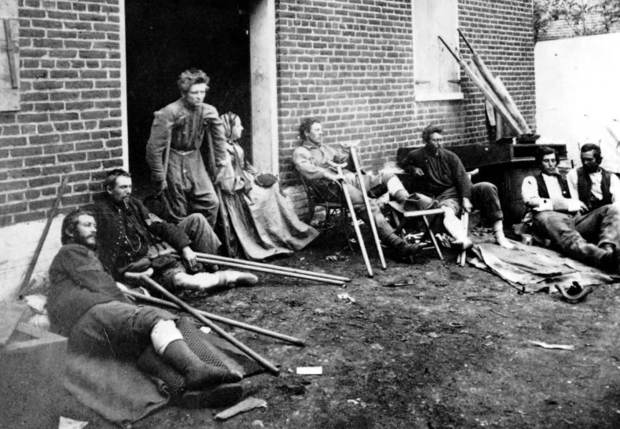
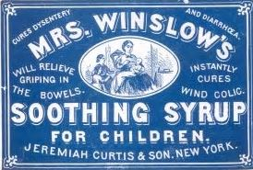
Post-Civil War through 1900s
In decades after Civil War, U.S. developed a narcotics habit when disabled veterans became addicted to morphine.
Genteel “society ladies” dosed up with Laudanum — a tincture of alcohol and opium.
This “wonder drug” was widely used as a cough suppressant and sold as “elixirs” and “syrups.”
And proved very effective at treating diarrhea in children—until infant deaths occurred.

Slide 16
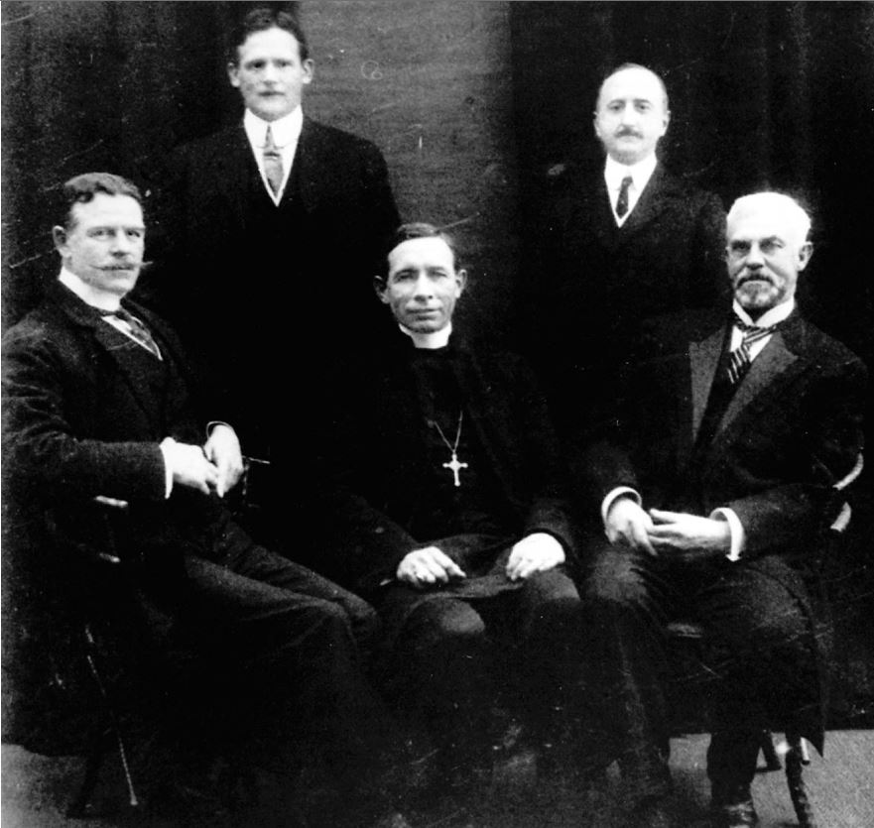
“The Greatest Drug Fiends in the World” Miroff, N. Washington Post (2017) quoting Hamilton Wright in 1908
U.S. delegation to the International Opium Conference at The Hague in 1911.
America’s first Opium Commissioner Hamilton Wright is at left.

Slide 17
Government Reacts to Opium Crisis
1890
U.S. government began taxing opium.
1906
Pure Food and Drug Act forced manufacturers to disclose the contents of their products, so consumers wary of opium would know if it was in their children’s cough syrup.
1909
Congress passed the Opium Exclusion Act, banning its import for the purpose of smoking opium.

Slide 18
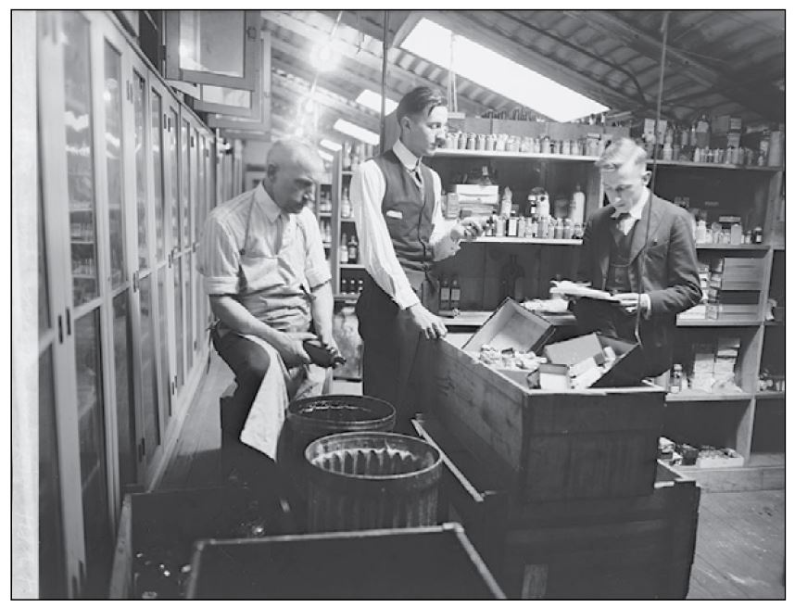
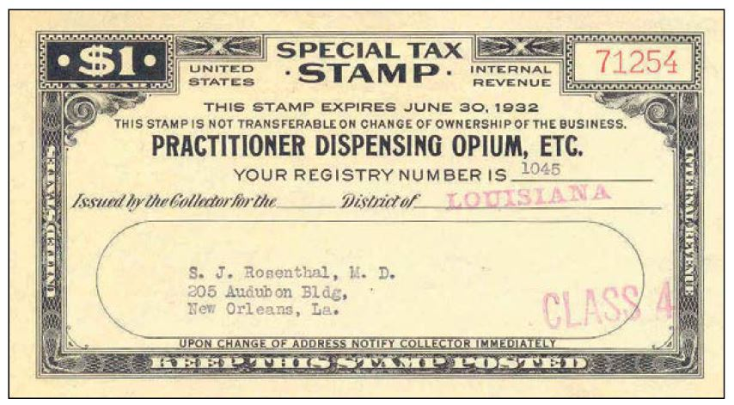
1914—Harrison Act Tax
Required anyone who imported, produced, sold, or dispensed “narcotics” (at that time meaning coca- as well as opium-based drugs) to register, pay a nominal tax, and keep detailed records. With such records, officials could better enforce existing laws, such as those requiring sale by prescription only.

Slide 19
Controlled Substances Act of 1970
Federal statute prescribing U.S. drug policy under which the manufacture, importation, possession, use and distribution of certain substances is regulated.
Replaced Harrison Act
Passed by Congress as Title II of the Comprehensive Drug Abuse Prevention and Control Act of 1970 and signed into law by President Nixon.
CSA created 5 Schedules in a hierarchy of production, prescribing and dispensing controls.

Slide 21
20th Century Drug Epidemics:
In the 1950s, amphetamines, developed in the 1930s, took off.
Marketed by drug companies and promoted by doctors, they were used for weight loss, anxiety and depression. Users who injected it were known as "speed freaks.“
In the 1960s and 1970s, heroin use surged, prompted in part by Vietnam War soldiers who were exposed to it while fighting overseas.
Unlike the doctor-driven previous drug epidemics, this one victimized poor inner-city neighborhoods most. There was little public compassion then for heroin addicts.
In the 1970s, heroin use faded but cocaine was on its way back from the early 1900s, first in powder form and then becoming an epidemic of crack cocaine in the mid-1980s when a supply glut prompted dealers to sell hardened cocaine rocks that sold for $5 to $10 on the street.

Slide 22
Opioid Epidemic Phases 1990s—2010… Prescription Painkillers 2010—Present…Heroin 2013—Present…Synthetic Opioids

Slide 23
Lifetime odds of death for selected causes, US, 2017
Cause of Death | Odds of Dying
Heart Disease | 1 in 6
Cancer | 1 in 7
Chronic Lower Respiratory Disease | 1 in 27
Suicide | 1 in 88
Opioid overdose | 1 in 96
Motor Vehicle Crash | 1 in 103
Fall | 1 in 114
Gun Assault | 1 in 285
Pedestrian Incident | 1 in 556
Motorcyclist | 1 in 858
.
Notes:
For the first time on record, your odds of dying from an accidental opioid overdose are greater than dying in a motor vehicle crash.
Source: National Safety Council estimates based on data from National Center for Health Statistics—Mortality Data for 2017, as compiled from data provided by the 57 vital statistics jurisdictions through the Vital Statistics Cooperative Program. Population and life expectancy data are from the U.S. Census Bureau. Deaths are classified on the basis of the Tenth Revision of the World Health Organization’s “The International Classification of Diseases” (ICD). Numbers following titles refer to External Cause of Morbidity and Mortality classifications in ICD-10.

Slide 24
Drug Overdose Death Rates: Aged 15 years or older by sex and age: United States, 2006–2016

Slide 30
Age-adjusted drug overdose deaths per 100,000 population: 2016

Slide 31
.

Slide 32
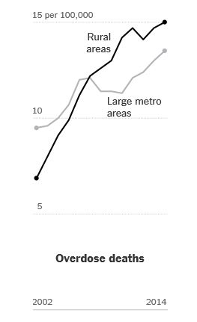
Disproportionate Unintentional Injury Death Rates: Rural vs. Urban
Death rates from overdoses in rural areas disproportionate to rates in metropolitan areas, which historically had higher rates in mid-20th century.
Sources: “Drug Poisoning Mortality: United States, 2002–2014” by Lauren M. Rossen, Brigham Bastian, Margaret Warner, Diba Khan and Yinong Chong, National Center for Health Statistics, Centers for Disease Control and Prevention

Slide 33
Data released in late October 2018
First indication of fatal opioid overdose death rate modulating.
https://www.cdc.gov/nchs/nvss/vsrr/drug-overdose-data.htm#notes

Slide 34
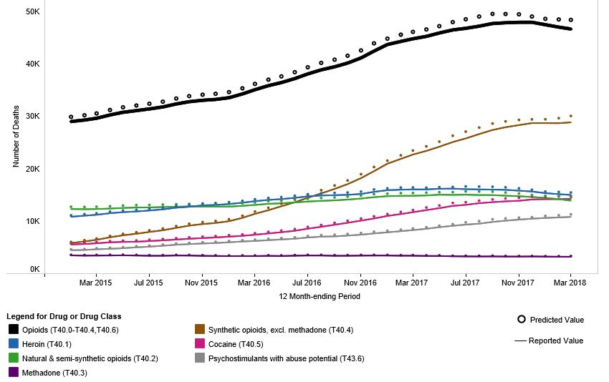

Slide 35
Causes
Socio-economic dislocation during Great Recession
Aggressive promotion to physicians
Profligate physician prescribing
Excessive shipments to pharmacy dispensers
224,260,980 oxycodone shipped to West Virginia, 2007-2012
555,808,292 hydrocodone shipped to West Virginia, 2007-2012
433 opioid pills for every man, woman and child in West Virginia
Limited availability of opioid use disorder treatment
Genetic predisposition
Others?

Slide 36
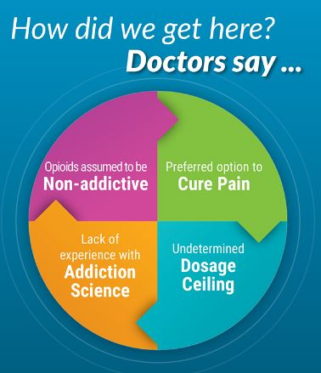
Medical Prescribing
In 1996, the American Pain Society said MDs were undertreating pain and proposed that pain is the 5th vital sign.
Physicians encouraged to screen patients for pain and to treat non-cancer pain to a degree not done before.
Drug companies began to educate physicians and the public that opioids were a fast solution to pain without addictive risk. This was false.
Prescription opioid use increased as insurers reimbursed physicians for opioid prescribing, creating a financial incentive.
All this made opioids the “go-to” drug for all types of pain management.

Slide 37
Interventions
Appropriate Prescribing
Public Health Measures
Overdose-Reversal
Treatments for Opioid Addiction
Interdiction

Slide 38
Appropriate Opioid Prescribing CDC Guideline for Prescribing Opioids for Chronic Pain — United States, 2016
Limit the prescribed opioid to the lowest effective dose for the shortest effective duration.
Regular monitoring
Minimize risks of long-term opioid use by allowing for the tapering and discontinuing of opioids among patients:
Who are not receiving a clear benefit; or
Among those engaging in practices that increase risk of overdose—such as:
Consuming high doses of alcohol
Concurrent use of benzodiazepines (Kowalski-McGraw et al. JOEM, 2016)
Poor adherence to precise dosing instructions

Slide 40
Calculating Total Daily Dose of Opioids https://www.cdc.gov/drugoverdose/pdf/calculating_total_daily_dose-a.pdf

Slide 41
Prescription Drug Monitoring Programs
State-run Programs
Collect and distribute data about the prescription and dispensation of federally controlled substances.
Pharmacies dispensing controlled substances and prescribers—pharmacy monitoring programs
Required to register with their respective state PMPs
Report dispensation of prescriptions to online database.
All states and the District of Columbia have the drug monitoring databases:
Fewer than five require their use; and
Less than 20% doctors use the databases when it is not required.

Slide 42
Electronic Prescribing
Computer-based electronic generation, transmission and filling of a medical prescription, taking the place of paper and faxed prescriptions.
E-prescribing is meant to reduce the risks associated with traditional prescription script writing. It is also one of the major reasons for the push for electronic medical records.
By sharing medical prescription information, e-prescribing seeks to connect the patient's team of healthcare providers to facilitate knowledgeable decision making
Only Maine, Minnesota, New York require e-prescribing
H.R. 3528—Every Prescription Conveyed Securely Act (July 2017)
Requires e-prescribing for all controlled substances under for Medicare Part D

Slide 43
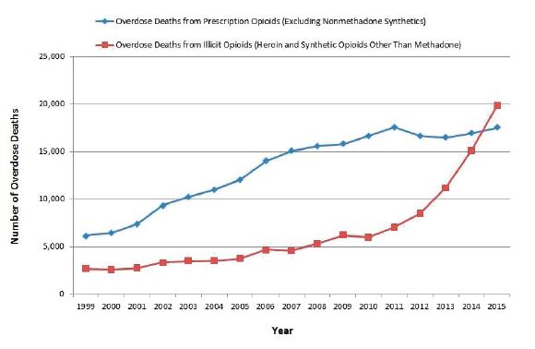
Licit or Illicit Use Driving the Epidemic?
National Academies of Sciences, Engineering, and Medicine. 2017. Pain management and the opioid epidemic: Balancing societal and individual benefits and risks of prescription opioid use. Washington, DC: The National Academies Press. doi: https://doi.org/10.17226/24781.

Slide 44
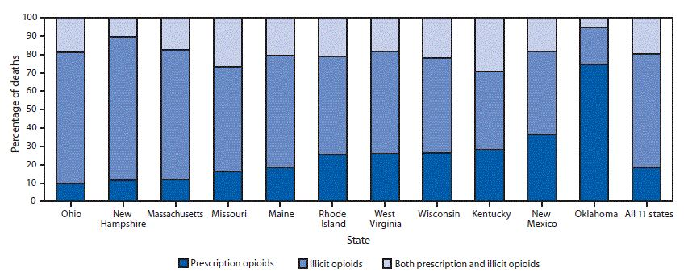
Proportion of Opioid Overdose Deaths
11 states, July 1, 2016–June 30, 2017
Mattson et al. MMWR. 2018:67(34):945-951

Slide 45
Public Health Measures
Risk awareness and education
Safe injection sites
Observation prevents unattended overdoses
Taking drugs under supervision
Drug testing stations:
Testing drugs for fentanyl contamination
Testing of an illicit drug for another illicit drug?
Federal Response

Slide 46
Overdose-Reversal Intervention
Naloxone for acute overdose
Prescription drug that can reverse the effects of opioid overdose and can be life-saving if administered in time.
Sold under name Narcan or Evzio.
Evzio, a prescription treatment that can be used by family members or caregivers to treat a person known or suspected to have had an opioid overdose.
Evzio rapidly delivers a single dose of the drug naloxone via a hand-held auto-injector.
Widespread distribution of naloxone — an overdose antidote — will save lives in acute cases, but naloxone can be administered “too late,” and it does not treat underlying addiction
Surgeon General Advisory, April, 2018

Slide 47
Naloxone Availability & Use In The Workplace https://www.cdc.gov/niosh/docs/2019-101/default.html

Slide 48
Naloxone: Establishing a Program
Risk assessment: Conduct a risk assessment before implementing the naloxone program.
Liability: Consider liability and other legal issues.
Records Management: Include formal procedures for documenting incidents and managing those records.
Staff Roles: Define clear roles and responsibilities for all persons designated to respond to a suspected overdose.
Training: Train staff to lower their risks when providing naloxone.
Purchasing and storing Naloxone: Naloxone is widely available in pharmacies, follow manufacturer instructions for storing, keeping it near all other PPE (gloves, etc.).
Follow-up care planning: Develop a plan for immediate care, referral, and ongoing support for any worker who has overdosed.
Maintenance: Re-evaluate your program periodically, assessing for new risks

Slide 49
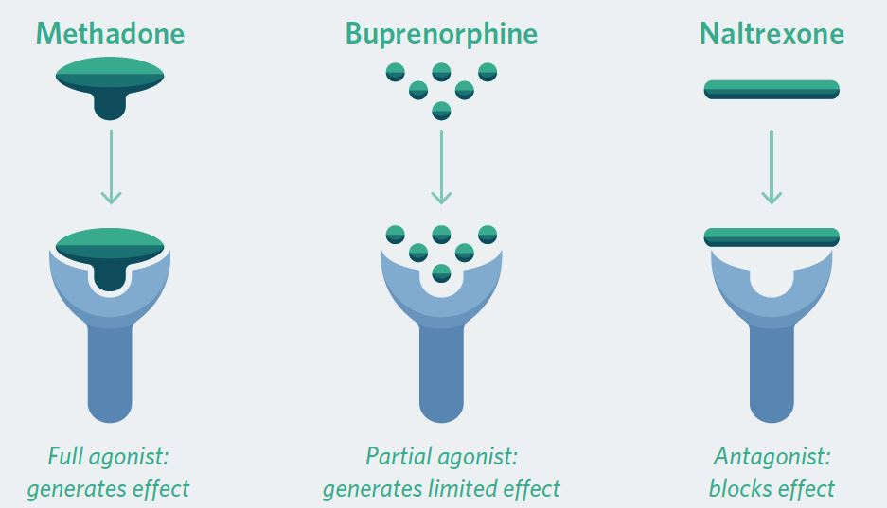
Medication Assisted Treatment
OUD is a chronic, relapsing illness. Lifetime treatment is necessary.

Slide 50
Tension between Abstinence and MAT
Research shows that staying in recovery and avoiding relapse for at least a year is more than twice as likely with medications and counseling as without them.
https://www.samhsa.gov/medication-assisted-treatment/treatment
Currently, there is limited access to MAT:
Too few addiction recovery specialists;
Insurance coverage is limited (private insurers and Medicaid);
Drug treatment center leaders and 12-step programs reject idea that an addict can recover by drug substitution;
Greater use of MAT negatively impacts residential drug recovery centers’ revenue

Slide 51
SUPPORT for Patients and Communities Act
TITLE VII—Public Health Provisions, Subtitle A—Awareness and Training.
SEC. 7002. First Responder Training
Section 546 of the Public Health Service Act (42 14 U.S.C. 290ee–1) is amended to “train and provide resources for first responders and members of other key community sectors on safety around fentanyl, carfentanil, and other dangerous licit and illicit drugs to protect themselves from exposure to such drugs and respond appropriately when exposure occurs.
‘‘$36,000,000 for each of fiscal years 2019 through 2023’’.

Slide 52
Scientific Strategies—NIH
Overdose Prevention and Reversal
Stronger opioid antagonists to counter very-high-potency synthetic opioids
Novel reversal medications (5-hydroxytryptamine type 1A)
Phrenic nerve simulation devices
Technologies to detect overdose, alert for help or auto-inject naloxone
Treatment of Opioid Use Disorder
New formulations of existing medications
Narcan nasal spray
Probuphine—surgically implanted device to deliver steady dose of buprenorphine
Novel medications and technologies—vaccines—to treat opioid addiction
Treatment of Chronic Pain
Opioid formulations with abuse-deterrent properties to make drug difficult to manipulate for snorting or injecting
MOR-biased agonists (TRV130) not associated with rewarding or respiratory effects
Drugs that target non-opioid pain pathways like the endocannabinoid system (THC)
Non-pharmacologic approaches

Slide 53
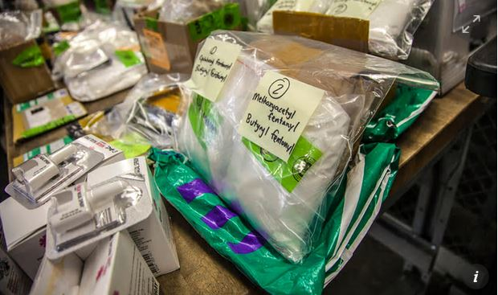
INTERDICT Act Signed by the President January 10, 2018
Ensures that Customs & Border Patrol will have additional portable chemical screening devices available at ports of entry and mail and express consignment facilities, and additional fixed chemical screening devices available in CBP laboratories.
Provides CBP with sufficient resources, personnel, and facilities – including scientists available during all operational hours – to interpret screening test results from the field.
Authorizes – based on CBP guidance – the appropriation of $9 million for hundreds of new screening devices, laboratory equipment, facilities, and personnel for support during all operational hours

Slide 57
What does work have to do with it?

Slide 58
Industry and Occupation Data
Construction and extraction workers had both a high rate (150.6 deaths per 100,000 workers) and a high number of opioid-related overdose deaths (n=1,096).
Opioid-related death rate for those employed in construction and extraction occupation was six times the average rate for all Massachusetts workers (25.1).
Construction and extraction workers accounted for more than 24% of all opioid-related deaths among the working population (n=4,302).

Slide 61
Opioid-Related Overdose Deaths and Number of Occupational Injury and Illnesses

Slide 62
Opioids and Workers’ Compensation
Pain management following work-related injuries can lead to opioid use disorder.
Franklin et al. Early opioid prescription and subsequent disability among workers with back injuries: the Disability Risk Identification Study Cohort. Spine. 2008;33(2):199-204.
Dembe et al. Opioid use and dosing in the workers’ compensation setting. A comparative review and new data from Ohio. AJIM. 2012;55(4):313-324.
There is a high proportion of persistent opioid use among injured workers in the workers’ compensation medical care.
Persistent use = injured workers who filled an opioid prescription beyond 90 days from injury.
O’Hara et al. Factors associated with persistent opioid use among injured workers’ compensation claimants. JAMA Network Open, 2018.

Slide 63
Correlates of Opioid Dispensing WCRI, December 2018
Workers in mining and construction more likely to receive opioids than workers in other industries and on a longer term basis and at higher doses.
Workers in small firms were more likely to receive opioids compared to larger firm workers.
Workers in counties with higher opioid dispensing rates and workers in rural counties were more likely to receive opioids.
Workers with neurologic spine pain were more likely to receive high-dose and longer term opioids, whereas workers with fractures or carpal tunnel who received opioids did not freqently receive then on a chronic basis or at high doses.
Workers age 40 or more were more likely than younger workers to receive opioids.

Slide 64
Change in Average MEA per Claim with Opioids— 2010/2012—2013/2015

Slide 65
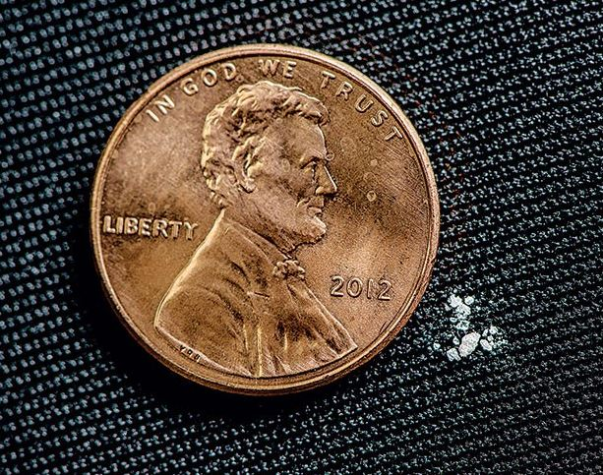
Fentanyl & First Responders
Fentanyl 50 times more potent than heroin
¼ milligram can be deadly
Standard low-dose aspirin is 81 milligrams
If you were to cut that tablet into 324 pieces, one of the pieces = ¼ milligram

Slide 66
Fentanyl
Potency
Fentanyl 50X to 100X more potent than morphine
Schedule II prescription drug used to treat cancer patients and patients with chronic severe pain or post-surgery pain.
Responders are finding that with overdoses involving fentanyl and carfentanil, the overdoses can be so severe that multiple doses of naloxone are needed.
Naloxone remains an effective reversal agents, but:
May be administered too late to restore breathing; or
Drug taken by the person was not an opioid.

Slide 67
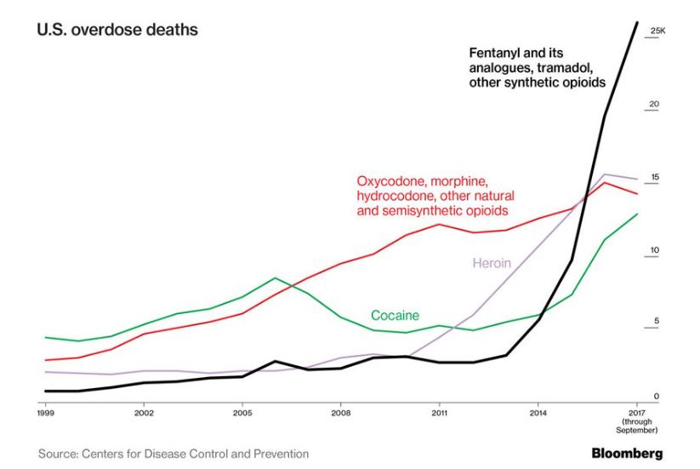

Slide 68
Responders Incidents
Reports of responders experiencing “adverse health effects” during opioid overdose victim incidents
Health effects are NOT classic (textbook-described) opioid overdose symptoms and signs such as apnea, cyanosis, constricted pupils may not occur:
Responders report feeling “unwell,” “nauseous,” “lightheaded, “dizzy,” “feeling like I was going-down”
Some responders given naloxone at the scene with variable responses.

Slide 69
First Responders and Opioids
Unclear whether cause of responders’ health effects is exposure to mixture of opioids and stimulants during the incident, or anxiety resulting from risk perception, or a combination of both
NIOSH is conducting investigation of response incidents where adverse health effects occur.
Regardless of causation, protective strategies need to be implemented.

Slide 70
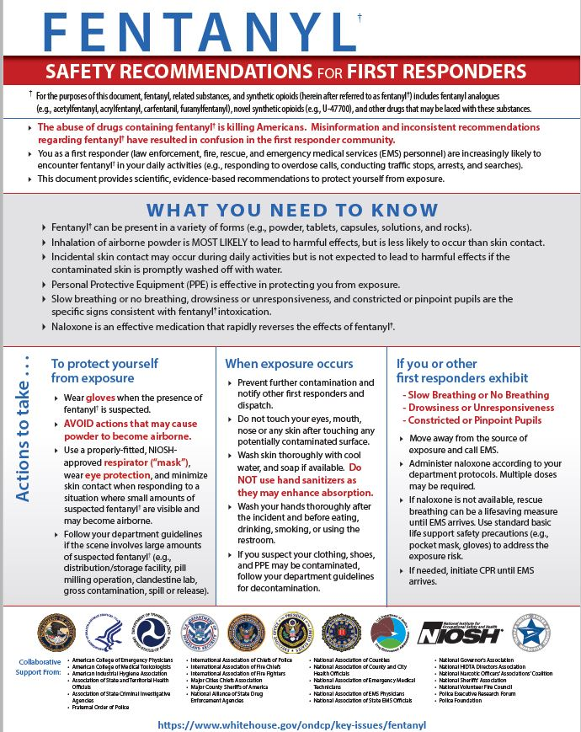
First Responder Guidance
Interagency group under the direction of the National Security Council.
Actions first responders can take to protect themselves from exposure.
Actions first responders can take when exposure occurs.
Actions first responders can take when they or their partners exhibit signs of intoxication.

Slide 71
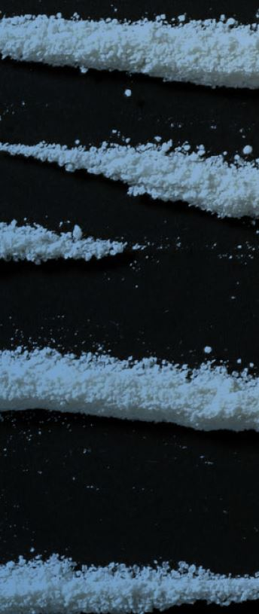
Summary
Opioid use disorders and overdose deaths continue at epidemic levels with some early indication of modulation.
Since 2012, opioid prescribing rates since suggest physicians are responding and illicit use may be a stronger driver of opioid use.
Supply-side and demand-side interventions are needed:
Prescribing controls by connecting physician, pharmacist, and patient electronically
Promoting opioid use disorder recovery through wider availability of Medication Assisted Treatment
Increase use of existing non-opioid pain therapies
Developing new non-opioid pain therapies
Interrupting illicit supply chains

Slide 72
References
Ahmed FB et al. Provisional drug overdose death counts. National Center for Health Statistics, 2018.
Al-Hasani, R. et al. Molecular mechanisms of opioid receptor-dependent signaling and behavior. Anesthesiology. 2011; 115(6): 1363–1381.
American Association of Poison Controls Centers. 2016 Annual Report. https://aapcc.s3.amazonaws.com/pdfs/annual_reports/12_21_2017_2016_Annua.pdf
Birnbaum, H. et al. Societal costs of prescription opioid abuse, dependence, and misuse in the United States. Pain Medicine. 2011;12(4): 657–667.
Center for Behavioral Health Statistics and Quality (CBHSQ). 2015 National Survey on Drug Use and Health: Detailed Tables. Rockville, MD: Substance Abuse and Mental Health Services Administration; 2016.
Center for Disease Control and Prevention. Guidelines for Prescribing Opioids for Chronic Pain. MMWR. Recommendations and Reports. March 18, 2016;65(1):1–49.
Centers for Disease Control and Prevention. 2018 Annual Surveillance Report of Drug-Related Risks and Outcomes — United States. Surveillance Special Report. Centers for Disease Control and Prevention, U.S. Department of Health and Human Services. Published August 31, 2018.
Chang AK et al. Effect of a single does of oral opioid and non-opioid analgesics on acute extremity pain in the emergency department. JAMA. 2017;318(17):1661-1667.
Cheng M et al. Comparison of opioid-related deaths by work-related injury. AJIM. 2013;56(3):308-316.

Slide 73
References
Chou et al. Management of suspected opioid overdose with Naloxone in out-of-hospital settings. Annals Internal Medicine. 2017;167:867-875.
Compton WM et al. Relationship between nonmedical prescription-opioid use and heroin use. NEJM. 2016;374(2):154-163.
Connery, HS. Medication-assisted treatment of opioid use disorder: review of the evidence and future direction. Harv Rev Psychiatry 2015;23(2)63-75.
Dembe A et al. Opioid use and dosing in the workers’ compensation setting. A comparative review and new data from Ohio. AJIM. 2012;55(4):313-324
Dowell, D. et al. CDC Guideline for Prescribing Opioids for Chronic Pain — United States, 2016. MMWR Recomm Rep 2016;65(No. RR-1):1–49.
Dowell, D. et al. Contribution of opioid-involved poisoning to the change in life expectancy in the United States, 2000-2015 JAMA. 2017;318(11):1065-1067.
Dowell D. Underlying factors in drug overdose deaths. JAMA. 2017;318(23):2295-2296.
Franklin GM et al. Early opioid prescription and subsequent disability among workers with back injuries. Spine. 33(2):199-204.

Slide 74
References
Guy GP et al. Vital signs: changes in opioid prescribing in the U.S., 2006-2015. MMWR. 2017;66(26):697-704.
Halford B. Looking beyond opioids for safer pain relief. CEN/ACS. November 13, 2017.
Hauser, W. et al. The opioid epidemic and the long term opioid therapy for chronic non-cancer pain revisited: A transatlantic perspective. Pain Management. 2016; 6(3):249-263.
Hedegaard H et al. Drug overdose deaths in the United States, 1999-2016. NCHS Data Brief, No. 294, Dec 2017
Hiolski E. Powerful detection technology for powerful new street drugs. CEN/ACS. November 13, 2017.
Howard J & Hornsby-Myers J et al. Fentanyls and the safety of first responders: science and recommendations. AJIM. 2018:1-7.
Hughes, A. et al. 2016. Prescription Drug Use and Misuse in the United States: Results from the 2015 National Survey on Drug Use and Health. SAMHSA.
Katz, J. 2017, August 10. Short answers to hard questions about the opioid crisis. New York Times. https://www.nytimes.com/interactive/2017/08/03/upshot/opioid-drug-overdose-epidemic.html
Katz J. 2017, June 5. Drug deaths in American are rising faster than ever. New York Times. https://www.nytimes.com/interactive/2017/06/05/upshot/opioid-epidemic-drug-overdose-deaths-are-rising-faster-than-ever.html

Slide 75
References
Katz J. 2017, June 5. Drug deaths in American are rising faster than ever. New York Times. https://www.nytimes.com/interactive/2017/06/05/upshot/opioid-epidemic-drug-overdose-dea
Kiang MV et al. 2019. Assessment of changes in the geographical distribution of opioid-related mortality across the United States by opioid type. JAMA Open Network. Doi:10.1001/jamanetworkopen.2019.0040
Kochanek KD et al. 2016. Mortality in the U.S., NCHS Data Brief 293. December, 2017. https://www.cdc.gov/nchs/data/databriefs/db293.pdf
Kowalski-McGraw M et al. Characterizing the interrelationships of prescription opioid and benzodiazepine drugs with worker health and workplace hazards. JOEM. 2017;59;1114-1126.
Krueger AB. Where have all the workers gone? An inquiry into the decline of the U.S. labor force participation rate. Brookings Papers, 2017. https://www.brookings.edu/wp-content/uploads/2017/09/1_krueger.pdf
Macy B. Dopesick: Dealers, Doctors and the Drug Company that Addicted America. New York, NY: Little, Brown and Company, 2018.
Lipton B et al. Workers compensation prescription drug study 2013 update. Retrieved from National Council on Compensation Insurance Inc. (2013, August).
Manchikanti, L. et al. Opioid epidemic in the United States. Pain Physician. 2012;15:ES9-ES.

Slide 76
References
Manchikanti, L. et al. Opioid epidemic in the United States. Pain Physician. 2012;15:ES9-ES.
Massachusetts Department of Public Health, Occupational Health Surveillance Program (2018): Opioid-related Overdose Deaths in Massachusetts by Industry and Occupation, 2011-2015
Mattick, RP. et al., Methadone maintenance therapy versus no opioid replacement therapy for opioid dependence,” Cochrane Database of Systematic Reviews 3 (2009):38.
Meier B. In guilty plea, OxyContin maker to pay $600 million. New York Times. May 10, 2007. http://www.nytimes.com/2007/05/10/business/11drug-web.html
Miroff, N. 2017, September 29. “The greatest drug fiends in the world”—an American opioid crisis in 1908. Washington Post. https://www.washingtonpost.com/news/retropolis/wp/2017/09/29/the-greatest-drug-fiends-in-the-world-an-american-opioid-crisis-in-1908/?utm_term
Moran C. Marsh Risk Consulting. Opioid litigation: trends and risk management opportunities. October, 2018.
Morano LH et al. Occupational patterns in unintentional and undetermined drug-involved and opioid-involved overdose deaths, 2007-2012. MMWR. 2018;67(33):925-930

Slide 77
References
National Academies of Sciences, Engineering, and Medicine. 2017. Pain management and the opioid epidemic: Balancing societal and individual benefits and risks of prescription opioid use. Washington, DC: The National Academies Press.
National Academies of Sciences, Engineering, and Medicine. 2017. Pain management and the opioid epidemic: Balancing societal and individual benefits and risks of prescription opioid use. Washington, DC: The National Academies Press.
National Academies of Sciences, Engineering, and Medicine. 2017. Pain management and the opioid epidemic: Balancing societal and individual benefits and risks of prescription opioid use. Washington, DC: The National Academies Press. doi: https://doi.org/10.17226/24781.
National Safety Council. 2017. The proactive role employers can take: opioids in the workplace. http://www.nsc.org/RxDrugOverdoseDocuments/proactive-role-employers-can-take-opioids-in-the-workplace.pdf
Nguyen TM. Abuse-deterrent opioids: worth the effort and cost? CEN/ACS. November 13, 2017.
O’Hara NN. Factors associated with persistent opioid use among injured workers’ compensation claimants. JAMA Network Open. 2018:doi:10/jamanetworkopen.2018.4050

Slide 78
References
Pew Charitable Trusts. Medication-assisted treatment improves outcomes for patients with opioid use Disorder. November, 2016. http://www.pewtrusts.org/~/media/assets/2016/11/medicationassistedtreatment_v3.pdf
Porter J, Jick H. Addiction rare in patients treated with narcotics. NEJM. 1980;302:123.
President’s Commission on Combating Drug Addiction and the Opioid Crisis. November 1, 2017. https://www.whitehouse.gov/sites/whitehouse.gov/files/images/Final_Report_Draft_11-1-2017.pdfand the opioid crisis. NEJM. 2017;377:2512-2517.
Riches JR et al. Analysis of clothing and urine from Moscow theatre siege casualties reveals carfentanil and remifentanil use. Journal of Analytical Toxicology. 2012;36:647-656.
Rossen LM, Bastian B, Warner M, Khan D, Chong Y. Drug poisoning mortality: United States, 1999–2016. National Center for Health Statistics. 2017. https://www.cdc.gov/nchs/data-visualization/drug-poisoning-mortality/
Rudd RA et al. Increases in drug and opioid-involved overdose deaths — United States, 2010–2015. MMWR. 2016;65(50-51):1445-1452.
Rutkow L et al. Emergency legal authority and the opioid crisis. NEJM. 2017;377:2512-2517.

Slide 79
References
Stover BD et al. Factors associated with early opioid prescription among workers with low back injuries. The Journal of Pain. 2006;7(10): 718-725.
Substance Abuse and Mental Health Services Administration (SAMHSA). Center for Behavioral Health Statistics and Quality. Treatment Episode Data Set (TEDS): 2001–2011. National Admissions to Substance Abuse Treatment Services. Rockville, MD: SAMHSA, BHSIS Ser. S-65, DHHS Publ. No. SMA 13-4772; 2013.
Sulman H et al. Opioids in the workplace. Issue Brief, the Massachusetts Policy Forum. November 1, 2018. http://masshealthpolicyforum.brandeis.edu/forums/Documents/Opioids%20in%20the%20Workforce2018/Issue%20Brief%20Opioids%20in%20the%20Workforce.FINAL.pdf
Thumala V et al. Interstate variations in use of opioids, 4th edition, WCRI-17-28,m June, 2017. https://www.wcrinet.org/reports/interstate-variations-in-use-of-opioids-4th-edition
Van Zee A. The promotion and marketing of oxycontin: commercial triumph, public health tragedy. Am J Public Health. 2009;99(2):221-227.
Volkow ND, McLellan AT. Opioid abuse in chronic pain—misconceptions and mitigation strategies. NEJM. 2016;374:1253-1263.
Volkow N, Collins F. The role of science in addressing the opioid crisis. NEJM. 2017; 377: 391-394.

